Slide 1
chaper 2
e
Introduction to
Structured Query
Language

Slide 2
chaper 2 Objectives
To understand the use of extracted data sets.
To understand the use of ad-hoc queries.
To understand the history and significance of Structured Query Language (SQL).
To understand the SQL SELECT/FROM/WHERE framework as the basis for database queries.
To create SQL queries to retrieve data from a single table
To create SQL queries that use the SQL SELECT, FROM, WHERE, ORDER BY, GROUP BY, and HAVING clauses
To create SQL queries that use the SQL DISTINCT, AND, OR, NOT, BETWEEN, LIKE, and IN keywords
To create SQL queries that use the SQL built-in functions of SUM, COUNT, MIN, MAX, and AVG with and without the SQL GROUP BY clause
To create SQL queries that retrieve data from a single table while restricting the data based upon data in another table (subquery)
To create SQL queries that retrieve data from multiple tables using the SQL JOIN operation
YOUR SITE HERE

Slide 3
Contents
1. Cape Codd Outdoor Sports
2. SQL Background
3. The SQL SELECT/FROM/WHERE Framework
4. Submitting SQL Statements to the DBMS
5. SQL Enhancements for Querying a Single Table
YOUR SITE HERE

Slide 4
Contents
8. Grouping in SQL SELECT Statements
6. Performing Calculations in SQL Queries
9.Looking for Patterns in NASDAQ Trading
7.Grouping in SQL SELECT Statements
8.Looking for Patterns in NASDAQ Trading
9. Querying Two or More Tables with SQL
YOUR SITE HERE

Slide 5
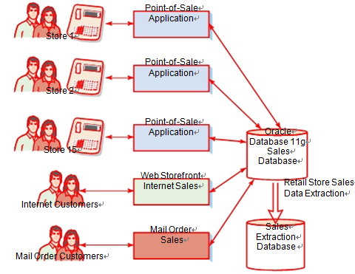
1. Cape Codd Outdoor Sports
For our work in this chapter, we will use data from Cape Codd Outdoor Sports (although based on a real outdoor retail equipment vendor, Cape Codd Outdoor Sports is a fictitious company). Cape Codd sells recreational outdoor equipment in 15 retail stores across the United States and Canada. It also sells merchandise over the Internet from a Web storefront application and via mail order. All retail sales are recorded in a sales database managed by an Oracle Database 11g DBMS, as shown in Figure 2-1.
Figure2-1
The Cape Codd Retail Sales Data Extraction

Slide 6
1. Cape Codd Outdoor Sports
The Retail Sales Data Extraction
Cape Codd’s marketing department wants to perform an analysis of in-store sales. Accordingly, marketing analysts ask the IT department to extract retail sales data from the operational database. To perform the marketing study, they do not need all of the order data. They want just the tables and columns shown in Figure 2-2. The data types for the columns in the tables is shown in Figure 2-3.
As shown in Figures 2-2 and Figures 2-3, three tables are needed: RETAIL_ORDER, ORDER_ITEM, and SKU_DATA. The RETAIL_ORDER table has data about each retail sales order, the ORDER_ITEM table has data about each item in an order, and the SKU_DATA table has data about each stock-keeping unit (SKU). SKU is a unique identifier for each particular item that Cape Codd sells. The data stored in the tables is shown in Figure 2-4.

Slide 7
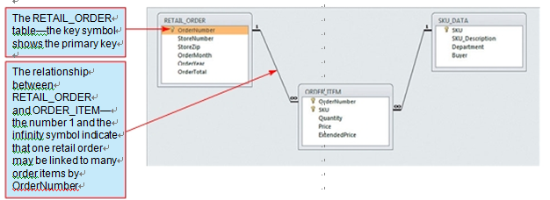
1. Cape Codd Outdoor Sports
The Retail Sales Data Extraction
Figure 2-2
Cape Codd Extracted Retail Sales Data Database Tables and Relationships

Slide 8
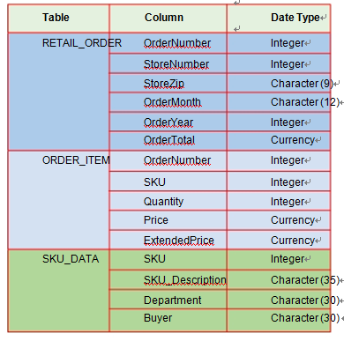
1. Cape Codd Outdoor Sports
The Retail Sales Data Extraction
Figure 2-3
Cape Codd Extracted Retail Sales Data Format

Slide 9
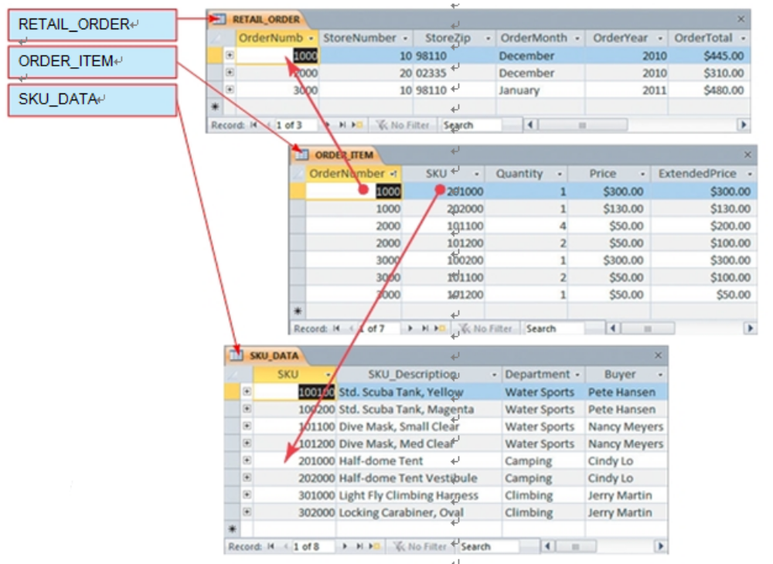
1. Cape Codd Outdoor Sports
The Retail Sales Data Extraction
Figure 2-4
Sample Data in the Cape Codd
Extracted Retail Sales Database

Slide 10
1. Cape Codd Outdoor Sports
RETAIL_ORDER Data
As shown in Figures 2-2 and 2-3, the RETAIL_ORDER table has columns for OrderNumber, StoreNumber, StoreZip (the zip code of the store selling the order), OrderMonth, OrderYear, and OrderTotal:
RETAIL_ORDER (OrderNumber, StoreNumber, StoreZip, OrderMonth, OrderYear, OrderTotal)
Sample data for RETAIL_ORDER is shown in Figure 2-5. This extract only includes data for retail store sales, and operational data for other types of sales (and returns and other salesrelated transactions) are not copied during the extraction process. Further, the data extraction process selects only a few columns of the operational data—the Point of Sale (POS) and other sales applications process far more data than that shown here. The operational database also stores the data in a different format. For example, the order data in the an Oracle Database 11g DBMS operational database contains a column named OrderDate that stores the data in the date format MM/DD/YYYY (e.g., 10/22/2010 for October 22, 2010). The extraction program used to populate the retail sales extracted data database converts OrderDate into two separate values of OrderMonth and OrderYear. This is done because this is the data format that marketing wants. Such filtering and data transformation are typical of a data extraction process.

Slide 11
1. Cape Codd Outdoor Sports
ORDER_ITEM Data
As shown in Figures 2-2 and 2-3, the ORDER_ITEM table has columns for OrderNumber, SKU, Quantity, Price, and ExtendedPrice (which equals Quantity × Price):
ORDER_ITEM (OrderNumber, SKU, Quantity, Price, ExtendedPrice)
Thus, the ORDER_ITEM table stores an extract of the items purchased in each order. There
is one row in the table for each item in an order, and this item is identified by its SKU. To understand this table, think about a sales receipt you get from a retail store. That receipt has data for one order. It includes basic order data such as the date and order total, and it has one line for each item you purchase. The rows in the ORDER_ITEM table correspond to the lines on such an order receipt.
The OrderNumber Column in ORDER_ITEM relates each row in ORDER_ITEM to the corresponding OrderNumber in the RETAIL_ORDER table. SKU identifies the actual item purchased by its stock-keeping unit number. Further, the SKU column in ORDER_ITEM relates each row in ORDER_ITEM to its corresponding SKU in the SKU_DATA table (discussed in the next section). Quantity is the number of items of that SKU purchased in that order. Price is the price of each item, and ExtendedPrice is equal to Quantity × Price.

Slide 12
1. Cape Codd Outdoor Sports
ORDER_ITEM Data
ORDER_ITEM data are shown in the bottom part of Figure 2-4. The first row relates to
order 1000 and to SKU 201000. For SKU 201000, one item was purchased for $300.00, and the ExtendedPrice was $300.00. The second row shows the second item in order 1000. There, 1 of item 202000 was purchased for $130.00 and the ExtendedPrice is 1 × $130.00, or $130.00. This table structure of an ORDER table related to an ORDER_ITEM table is typical for sales system with many items in one order. We will discuss it in detail in Chapters 5 and 6, where we will create a data model of a complete order and then design the database for that data model.
By the way You would expect the total of ExtendedPrice for all rows for a given order
to equal OrderTotal in the RETAIL_ORDER table. They do not. For order 1000, for example,
the sum of ExtendedPrice in the relevant rows of ORDER_ITEM is $300.00 + $130.00 = $430.00.
However, the OrderTotal for order 1000 is $445.00. The difference occurs because OrderTotal
includes tax, shipping, and other charges that do not appear in the data extract.

Slide 13
1. Cape Codd Outdoor Sports
SKU_DATA Table
As shown in Figures 2-3 and 2-4, the SKU_DATA table has columns SKU, SKU_Description, Department, and Buyer:
SKU_DATA (SKU, SKU_Description, Department, Buyer)
SKU is an integer value that identifies a particular product sold by Cape Codd. For example, SKU 100100 identifies a yellow, standard-size SCUBA tank, whereas SKU 100200 identifies the magenta version of the same tank. SKU_Description contains a brief text description of each item. Department and Buyer identify the department and individual who is responsible for purchasing the product. As with the other tables, these columns are a subset of the SKU data stored in the operational database.

Slide 14
1. Cape Codd Outdoor Sports
Data Extracts Are Common
Before we continue, realize that the data extraction process described here is not just
an academic exercise. To the contrary, such extraction processes are realistic,
common, and important BI system operations. Right now, hundreds of businesses
worldwide are using their BI systems to create extract databases just like the one
created by Cape Codd.
In the next sections of this chapter, you will learn how to write SQL statements to
process the extracted data via ad-hoc SQL queries, which is how SQL is used to “ask
questions” about the data in the database. This knowledge is exceedingly valuable
and practical. Again, right now, as you read this paragraph, hundreds of people are
writing SQL to create information from extracted data. The SQL you will learn in this
Chapter will be an essential asset to you as a knowledge worker, application
programmer, or database administrator. Invest the time to learn SQL—the investment
will pay great dividends later in your career.

Slide 15
2. SQL Background
SQL was developed by the IBM Corporation in the late 1970s. It was endorsed as a national
standard by the American National Standards Institute (ANSI) in 1986 and by the International
Organization for Standardization (ISO) (and no, that’s not a typo—the acronym is ISO, not IOS!)
in 1987. Subsequent versions of SQL were adopted in 1989 and 1992. The 1992 version is
sometimes referred to as SQL-92, or sometimes as ANSI-92 SQL. In 1999, SQL:1999 (also
referred to as SQL3), which incorporated some object-oriented concepts, was released. This was
followed by the release of SQL:2003 in 2003, SQL:2006 in 2006, and, most recently, SQL:2008
in 2008. Each of these added new features or extended existing SQL features, the most important
of which for us is SQL support for Extensible Markup Language (XML). (XML is discussed in
Chapter 12.) Our discussion in this chapter and in Chapter 7 focuses on common language
features that have been in SQL since SQL-92, but does include some features from SQL:2003 and
SQL:2008. We discuss the SQL XML features in Chapter12.
SQL is not a complete programming language, like Java or C#. Instead, it is called a data
sublanguage, because it has only those statements needed for creating and processing database
data and metadata. You can use SQL statements in many different ways. You can submit them
directly to the DBMS for processing. You can embed SQL statements into client/server application
programs. You can embed them into Web pages, and you can use them in reporting and data
extraction programs. You also can execute SQL statements directly from Visual Studio.NET and
other development tools.

Slide 16
2. SQL Background
SQL statements are commonly divided into categories, three of which are
of interest to us here:
• Data definition language (DDL) statements, which are used for creating tables, relationships, and other structures
• Data manipulation language (DML) statements, which are used for querying, inserting, modifying, and deleting data
This chapter considers only DML statements for querying data. The remaining DML
statements for inserting, modifying, and deleting data are discussed in Chapter 7, where we
will also discuss SQL DDL statements.
SQL is ubiquitous, and SQL programming is a critical skill. Today, nearly all DBMS
products process SQL, with the only exceptions being some of the emerging NoSQL
movement products. Enterprise-class DBMSs such as Microsoft SQL Server 2008 R2,
Oracle Database 11g, Oracle MySQL 5.5, and IBM DB2 require that you know SQL. With
these products, all data manipulation is expressed using SQL.

Slide 17
2. SQL Background
As explained in Chapter 1, if you have used Microsoft Access, you have used SQL,
even if you didn’t know it. Every time you process a form, create a report, or run a query
Microsoft Access generates SQL and sends that SQL to Microsoft Access’ internal ADE
DBMS engine. To do more than elementary database processing, you need to uncover the
SQL hidden by Microsoft Access. Further, once you know SQL, you will find it easier to
write a query statement in SQL rather than fight with the graphical forms, buttons, and
other paraphernalia that you must use to create queries with the Microsoft Access query-
by-example style GUI.

Slide 18
3. The SQL SELECT/FROM/WHERE Framework
This section introduces the fundamental statement framework for SQL query statements.
After we discuss this basic structure, you will learn how to submit SQL statements to
Microsoft Access, SQL Server, Oracle Database, and MySQL. If you choose, you can
then follow along with the text and process the SQL statements as they are explained in
the rest of this chapter. The basic form of SQL queries uses the SQL
SELECT/FROM/WHERE framework. In this framework:
• The SQL SELECT clause specifies which columns are to be listed in the query results.
• The SQL FROM clause specifies which tables are to be used in the query.
• The SQL WHERE clause specifies which rows are to be listed in the query results.
Let’s work through some examples so that this framework makes sense to you.

Slide 19
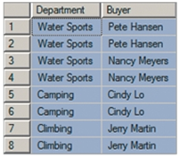
3. The SQL SELECT/FROM/WHERE Framework
Reading Specified Columns from a Single Table
We begin very simply. Suppose we want to obtain just the values of the Department
and Buyer columns of the SKU_DATA table. An SQL statement to read that data is the
following:
SELECT Department, Buyer
FROM SKU_DATA;
Using the data in Figure 2-4, when the DBMS processes this statement the result will be:
YOUR SITE HERE

Slide 20
3. The SQL SELECT/FROM/WHERE Framework
Reading Specified Columns from a Single Table
When SQL statements are executed, the statements transform tables. SQL
statements start with a table, process that table in some way, and then place the results
in another table structure. Even if the result of the processing is just a single number,
that number is considered to be a table with one row and one column. As you will
learn at the end of this chapter, some SQL statements process multiple tables.
Regardless of the number of input tables, though, the result of every SQL statement is a
single table.
Notice that SQL statements terminate with a semicolon (;) character. The semicolon
is required by the SQL standard. Although some DBMS products will allow you to
omit the semicolon, some will not, so develop the habit of terminating SQL statements
with a semicolon.
YOUR SITE HERE

Slide 21
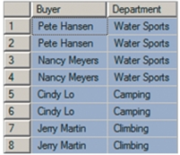
3. The SQL SELECT/FROM/WHERE Framework
Reading Specified Columns from a Single Table
The order of the column names in the SELECT phrase determines the order of the
columns in the results table. Thus, if we switch Buyer and Department in the SELECT
phrase, they will be switched in the output table as well. Hence, the SQL statement:
SELECT Buyer, Department
FROM SKU_DATA;
produces the following result table:
YOUR SITE HERE

Slide 22

3. The SQL SELECT/FROM/WHERE Framework
Reading Specified Columns from a Single Table
Notice that some rows are duplicated in these results. The data in the first and second
row, for example, are identical. We can eliminate duplicates by using the SQL
DISTINCT keyword, as follows:
SELECT DISTINCT Buyer, Department
FROM SKU_DATA;
The result of this statement, where all of the duplicate rows have been removed, is:
YOUR SITE HERE

Slide 23
3. The SQL SELECT/FROM/WHERE Framework
Reading Specified Columns from a Single Table
Suppose that we want to view all of the columns of the SKU_DATA table. To do so,
we can name each column in the SELECT statement as follows:
SELECT SKU, SKU_Description, Department, Buyer
FROM SKU_DATA;
By the way The reason that SQL does not automatically eliminate duplicate rows is that it
can be very time consuming to do so. To determine if any rows are duplicates, every row must
be compared with every other row. If there are 100,000 rows in a table, that checking will take a
long time. Hence, by default duplicates are not removed. However, it is always possible to force
their removal using the DISTINCT keyword.
YOUR SITE HERE

Slide 24
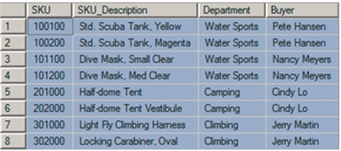
3. The SQL SELECT/FROM/WHERE Framework
Reading Specified Columns from a Single Table
The result will be a table with all of the rows and all four of the columns in
SKU_DATA:
However, SQL provides a shorthand notation for querying all of the columns of a
table. The shorthand is to use the SQL asterisk (*) wildcard character to indicate that
we want all the columns to be displayed:
SELECT *
FROM SKU_DATA;
YOUR SITE HERE

Slide 25
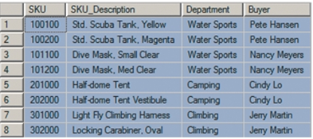
3. The SQL SELECT/FROM/WHERE Framework
Reading Specified Columns from a Single Table
The result will be a table with all of the rows and all four of the columns in
SKU_DATA:
YOUR SITE HERE

Slide 26
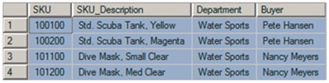
3. The SQL SELECT/FROM/WHERE Framework
Reading Specified Rows from a Single Table
Suppose we want all of the columns of the SKU_DATA table, but we want only the
rows for the Water Sports department. We can obtain that result by using the SQL
WHERE clause as follows:
SELECT *
FROM SKU_DATA
WHERE Department='Water Sports';
The result of this statement will be:
YOUR SITE HERE

Slide 27

3. The SQL SELECT/FROM/WHERE Framework
Reading Specified Rows from a Single Table
In an SQL WHERE clause, if the column contains text or date data, the comparison
values must be enclosed in single quotation marks ( '{text or date data}' ). If the
column contains numeric data, however, the comparison values need not be in quotes.
Thus, to find all of the SKU rows with a value greater than 200,000, we would use the
SQL statement (note that no comma is included in the numeric value code):
SELECT *
FROM SKU_DATA
WHERE SKU > 200000;
The result is:
By the way SQL is very fussy about single quotes. It wants the plain, nondirectional
quotes found in basic text editors. The fancy directional quotes produced by many word
processors will produce errors. For example, the data value 'Water Sports' is correctly stated,
but ‘Water Sports’ is not. Do you see the difference?
YOUR SITE HERE

Slide 28

3. The SQL SELECT/FROM/WHERE Framework
Reading Specified Columns and Rows from a Single Table
So far, we have selected certain columns and all rows and we have selected all columns
and certain rows. We can combine these operations to select certain columns and
certain rows by naming the columns we want and then using the SQL WHERE clause.
For example, to obtain the SKU_Description and Department of all products in the
Climbing department, we use the SQL query:
SELECT SKU_Description, Department
FROM SKU_DATA
WHERE Department='Climbing';
The result is:
YOUR SITE HERE

Slide 29

3. The SQL SELECT/FROM/WHERE Framework
Reading Specified Columns and Rows from a Single Table
SQL does not require that the column used in the WHERE clause also appear in the
SELECT clause column list. Thus, we can specify:
SELECT SKU_Description, Buyer
FROM SKU_DATA
WHERE Department='Climbing';
where the qualifying column, Department, does not appear in the SELECT clause
column list. The result is:
YOUR SITE HERE

Slide 30
3. The SQL SELECT/FROM/WHERE Framework
Reading Specified Columns and Rows from a Single Table
By the way Standard practice is to write SQL statements with the SELECT, FROM, and
WHERE clauses on separate lines. This practice is just a coding conven-
tion, however, and SQL parsers do not require it. You could code SQL-Query-CH02-09
all on one line as:
SELECT SKU_Description, Buyer FROM SKU_DATA WHERE Department=
'Climbing';
All DBMS products would process the statement written in this fashion. However, the standard
multiline coding convention makes SQL easier to read, and we encourage you to write your
SQL according to it.
YOUR SITE HERE

Slide 31
Thank You!
LOGO

